Slide 1
DiGITAL PORTFOLIO
Student : G. Abinaya
Register no : 36324U18001
Department :BSC (computer science)
College :Sree Abiraami Arts and Science for Women
University :Thiruvalluvar University
Email id : Abithirisha123@gmail.com

Slide 2
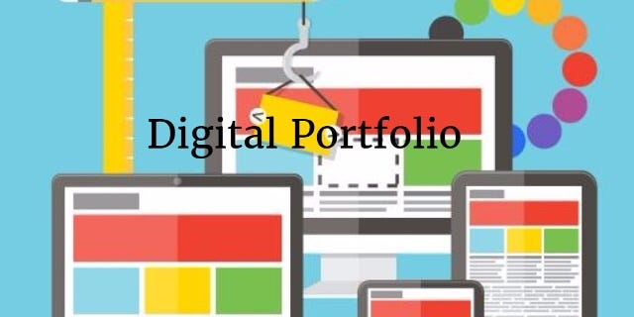
PROJECT TITLE Digital Portfolio

Slide 3
AGENDA
Problem Statement
Project Overview
End Users
Tools and Technologies
Portfolio design and Layout
Features and Functionality
Results and Screenshots
Conclusion
Github Link

Slide 4
PROBLEM STATEMENT
In today’s competitive academic and professional landscape, individuals struggle to
effectively showcase their skills, achievements, and projects in a structured, engaging, and
easily accessible format. Traditional resumes and physical portfolios are often static, lack
interactivity, and fail to highlight practical work samples such as coding projects, designs,
or research outputs.

Slide 5
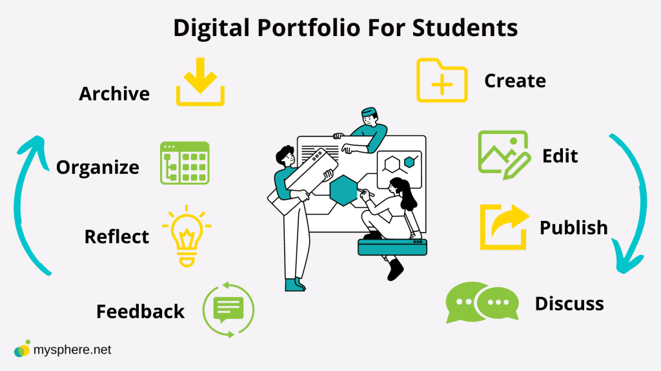
PROJECT OVERVIEW
The Digital Portfolio Project is aimed at designing and developing an online
platform that allows individuals to showcase their skills, achievements, and
experiences in a structured and visually appealing manner. Unlike a
traditional resume, a digital portfolio provides an interactive space to
present projects, multimedia content, certifications, and personal branding
elements.

Slide 6
END USER
Who: students, job seekers, professionals, freelancers, or creatives.
Why:
To showcase their skills, achievements, and projects.
To build a professional online presence.
To stand out from competition in job/academic applications.
To keep a continuously updated record of growth.

Slide 7
TOOLS AND TECHNOLOGIES
Frontend: HTML, CSS, JavaScript, React.js, Next.js, Angular, Vue.js
Backend: Node.js, Express.js, Django, Flask, Spring Boot
Databases: MySQL, PostgreSQL, MongoDB, Firebase
Version Control: Git, GitHub
Deployment: Vercel ,Netlify, Heroku, AWS, Azure, Google Cloud

Slide 8
PORTFOLIO DESIGN AND LAYOUT
Header
About Me/Home
Section Include
Conference certificate
Skill
Contact

Slide 9
FEATURES AND FUNCTIONALITY
home :*name ,tagline and a short intro (who you are what you do)
*professional photo or arater
about me :*background ,skills , interester
*short professional summary
skills:*icons /logos for programming language , tooles or software
*skill bars or percentages
contact:*email/ linkedin , github , behance etc.
*contact form (if you’re coding it)

Slide 10
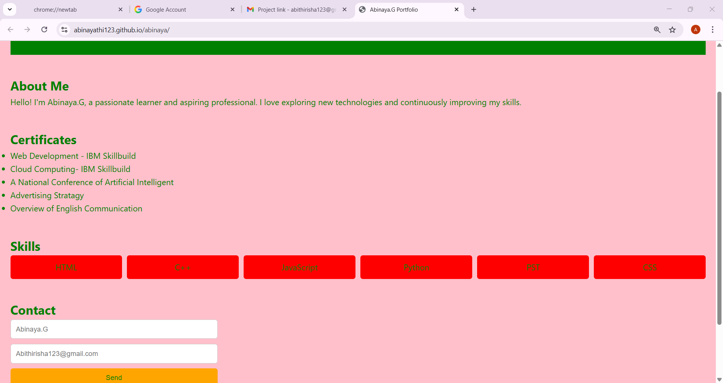
RESULTS AND SCREENSHOT

Slide 11
CONCLUSION
creating this digital portfolio has provided me with the opportunity to present
my skills, projects, and achievements in a structured and engaging way. It
serves as a reflection of my journey, showcasing not only my technical
expertise but also my ability to design, organize, and communicate
effectively.

Slide 12
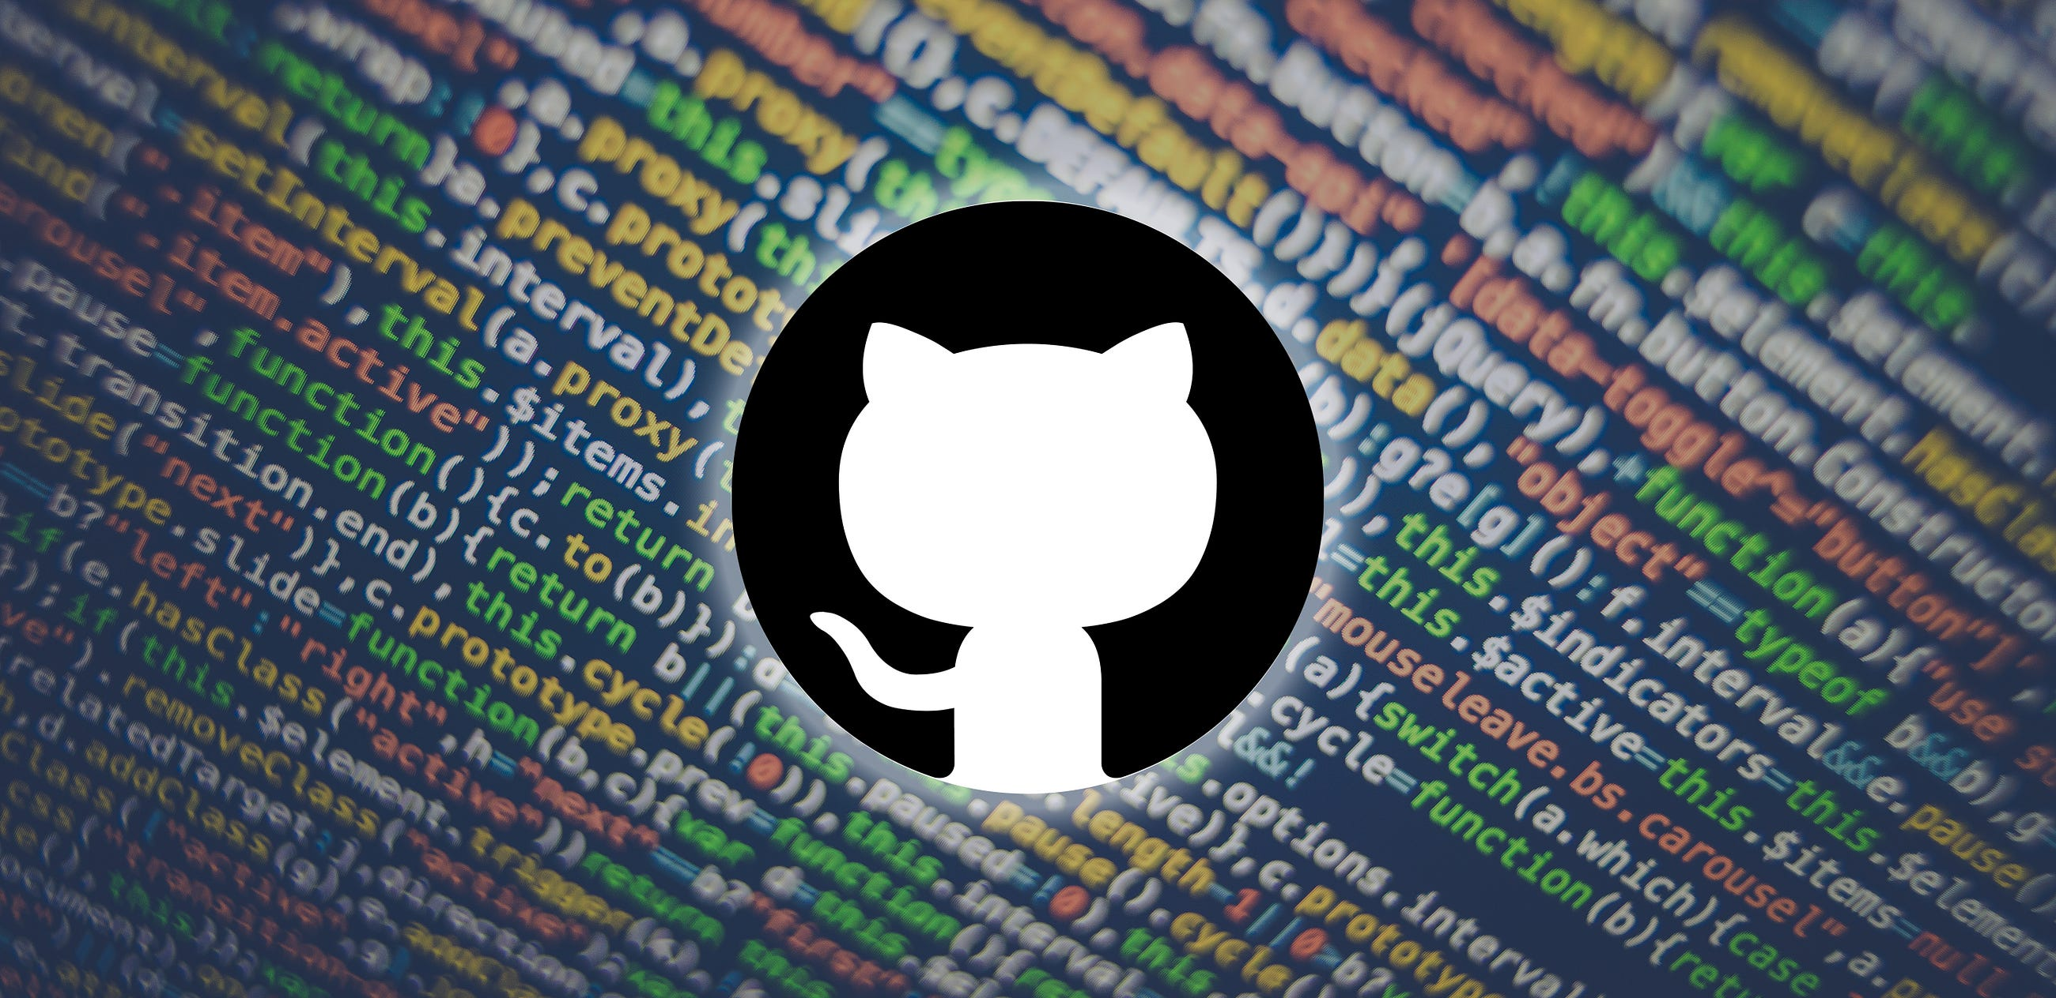
GITHUB LINK6
https://github.com/Abinayathi123

Slide 13


